Slide 1
Software
Engineering
COMP2225
Session 6-7: Software Development Process – Requirements and Specifications
Dr. Paul Walcott
Department of Computer Science, Mathematics and Physics
University of the West Indies, Cave Hill Campus
Barbados
NEXT

Slide 2
Session Objectives
On successful completion of this session a student will be able to:
  Describe the purpose and goals of requirements analysis
  Describe the purpose of a specification document
  Choose appropriate metrics for the requirements analysis phase
  Choose appropriate metrics for the specification phase

Slide 3
Session Objectives
  Compare and contrast requirements gathering techniques
  Compare and contrast different methods of presenting specification documents
  Apply appropriate testing strategies to the requirements analysis phase
  Apply appropriate testing strategies to the specification phase

Slide 4
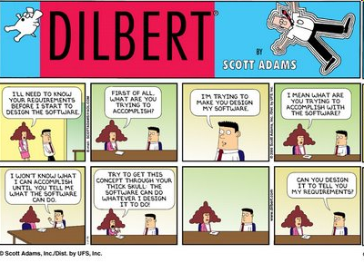

Slide 5
Introduction
The requirements phase is probably the most important phase of a software project.
If the wrong requirements are formulated then the wrong product will be built; which will be costly to correct.

Slide 6
Introduction Cont’d
The requirements phase is immediately followed by the specification phase (some authors combine these phases)
At the specification phase the requirements are clearly and concisely written down.

Slide 7
Introduction Cont’d
In this session we will be exploring both the requirements and specification phases.

Slide 8
The Requirements Phase

Slide 9
What is the purpose of requirements analysis?
To get a clear understanding of the client’s needs
May require examination of a current manual system
May require appraisal of a current computerised system
Requires members from client and developer organisations to meet
Notes:
The members of a software development team must have a clear understanding of what the software product must do.
The first step is to perform a thorough analysis of the client’s current situation, careful to define the situation as precisely as possible.
This analysis may require examination of a current manual system being operated, or may need an appraisal of some computerized system to be performed. Once a clear picture of the current situation is obtained, then the question of “What must the new product be able to do?” may be answered.
Requirements analysis begins with the requirements team meeting with members of the client organization. The initial meeting may be used to plan subsequent interviews or techniques for soliciting the relevant information from the client’s organization.
Several techniques can be employed to elicit requirements:

Slide 10
What are some of the goals of requirements gathering?
Attempt to identify problems in the current system
Avoid blindly taking statements about the client’s wants e.g. a wish list
Attempt to determine the real needs of the client
Notes:
During the requirements phase the developer must :-
Attempt to identify problems in the current system
Avoid blindly taking statements about the client’s wants e.g. a wish list
Attempt to determine the real needs of the client
Recognise the client is not always conscious of all the needs
Overcome any lack of computer-literacy on the part of the client i.e. bridge the technical divide between developer and client
Correctly interpret client’s requests even if not stated in the best way possible
The client may want s.q to control traffic lights and may request that the system use a 2.8 GHz processor, this is unnecessary and it is up to the developer to address this.

Slide 11
What are some of the goals of requirements gathering?
Recognise that the client is not always aware of all their needs
Overcome any lack of computer-literacy on the part of the client
Correctly interpret client’s requests even if not stated in the best possible way
Notes:
During the requirements phase the developer must :-
Attempt to identify problems in the current system
Avoid blindly taking statements about the client’s wants e.g. a wish list
Attempt to determine the real needs of the client
Recognise the client is not always conscious of all the needs
Overcome any lack of computer-literacy on the part of the client i.e. bridge the technical divide between developer and client
Correctly interpret client’s requests even if not stated in the best way possible
The client may want s.q to control traffic lights and may request that the system use a 2.8 GHz processor, this is unnecessary and it is up to the developer to address this.

Slide 12
What are some of the requirements gathering techniques?
Interviewing
Questionnaires
Client Documents
Observations
Scenarios
Rapid Prototypes
Notes:
There are several methods used for gathering information that will aid in establishing the real need of the client. These include interviewing, questionnaires, client documents,observations, scenarios, rapid prototypes.

Slide 13
Interviews | Questionnaires
May be structured or unstructured
Structured interviews have specific closed ended questions
Unstructured interviews have open ended questions which allow varied responses
Overcome the burden of multiple interviews
Can be filled out by large numbers of people
Lack interactivity
Must be carefully designed
Notes:
Interviews: Both the structured and unstructured interview may be planned. In the case of the structured interview a list of specific closed ended questions are posed and the answers recorded. E.g. “How long does it take to perform activity X” or “How many people are in the marketing dept?” or “How much was spent on the current system last month?” These type of targeted questions seek information the interviewer deems relevant in finding the true needs of the client. In the case of the unstructured interview open-ended questions are asked which allow the interviewee to outline broad areas or express views/opinions/convictions that may be hard to quantify. E.g. “Explain why the current product is unsatisfactory?” or “What are the best features of the current system?” or “What would be the most effective way to accomplish task X?” At the end of the interview process the interviewer prepares a written report outlining the results of the interview. Those interviewed should be given copies and allowed to add/clarify statements made.
Questionnaires: A well-structured questionnaire is a useful tool for gathering information. In the case of large departments/organizations it may be impractical to conduct numerous interviews. Unlike the interview process that is interactive in nature, there is no way to pose new questions (follow-ups) based on the answers given to previous questions. This means a skilful and methodical interviewer will obtain better information than that obtained using a well-developed and well-worded questionnaire.

Slide 14
Client Documents | Observations
Analysing documents in an organisation tells you a lot about the organisation
Detailed information can be captured
Types of data used can be traced
Use of video cameras can capture what happens in the office
Persons can go into the office environment and observe, then write a report
May be privacy issues
May be legal issues
Notes:
Client Documents
Another way to obtain information about a client’s operations is to examine the forms that are currently used. E.g. A purchase order may carry fields such as stock no., product code, quantity, etc. which shed light on the work flow in the organization.
Other documents such as job descriptions, internal reports, operating procedures etc. can also be very helpful.
Observations
Use of video cameras can be used to monitor what actually happens on the job in the office environment. The presence of cameras in the workplace may represent a privacy issue so careful consideration of all factors and the risks involved should be taken before embarking on this path. Legal issues may also be involved.

Slide 15
Scenarios
A scenario is an attempt to predict how a given product may be used by a client
The client then informs the developer of where the scenario deviates from what normally happens in practice
Can result in new requirements being discovered by the developer
Notes:
Scenarios
A scenario is a possible way in which a user can utilize the target product to accomplish some specific objective.
The developer may give a scenario of what output will be given by the product-to-be for a given input. The client representative then indicates what modifications will be needed for the scenario to correspond to what happens in practice.[This is a case where the s/w is being conformed to meet a manual system. Recall that this is an inherent difficult with building s/w]
Scenarios attempt to illustrate the behaviour of a future product in a way that the user can easily understand. This can result in new requirements being discovered by the developer.

Slide 16
Rapid Prototypes
Quickly implemented sketch of what some aspect of finished product ought to be
Client representatives allowed to investigate and experiment with prototype
Developer representatives watch and make notes of what they see
Rapid prototype changed many times until both developers and users are satisfied
May become the basis for specifications
Notes:
Rapid Prototypes
A rapid prototype can be built to exhibit key functionality of the product-to-be. The client/users then will experiment with the prototype. The development team watches the experimentation and makes notes. Users can also indicate where they feel changes are necessary. The rapid prototype is changed several times until both developers and users are satisfied that the rapid prototype currently embodies the key needs of the clients.
The rapid prototype then becomes a basis for creating the specifications document.
* Key Point – Rapid prototype must be built quickly and be capable of easy on-the-spot modification. This means being written in a 4GL or interpreted language (Such as Prolog, lisp, or java)

Slide 17
Rapid Prototype Development
May require an interpreted language such as Java, Smalltalk or UNIX shell programming language
May require a 4GL such as Oracle or PowerBuilder
Must be capable of rapid on-the-spot modification and redeployment
Notes:
Key Point – Rapid prototype must be built quickly and be capable of easy on-the-spot modification. This means being written in a 4GL or interpreted language (Such as Prolog, lisp, or java)
PowerBuilder is used in the RAD model to build data driven applications (e.g. ASP) (I.e. decisions are informed by and tested against systematically gathered and analysed information.

Slide 18
Testing must be done during the requirements phase!
Testing is a part of every phase of development
If a rapid prototype is built then the software quality assurance (SQA) group must ensure that the right people from the client organisation experiment with it.
The type of testing done at this phase requires the review of documents
Notes:
Note that the concept of testing during requirements is not new… recall the Waterfall Model.
All suggestions should be channeled to the client representatives (e.g. manager responsible for analysing user suggestions)

Slide 19
Some useful software tools include:
Interpreted languages (for rapid prototyping)
4GLs
  These languages reduce cost, effort and time
CASE tools
Notes:
Interpreted languages make good sense for building rapid prototypes as there is no lengthy compilation/linking process. Additionally small changes can be made “on-the-spot” with the client and the results seen immediately. Note that interpreted code tends to be less efficient than compiled code, however great efficiencies does not matter much for a rapid prototype.
Example interpreted languages are Smalltalk, lisp, prolog, java, perl and the UNIX shell programming language. Hypertext is also gaining in popularity (E.g. HTML). Alternatively to an interpreted language a 4GL such as Oracle, Powerbuilder or SQL may be used.
CASE tools with a particular built-in rapid prototyping language may be used to gain efficiency, however the high costs of such a CASE environment may not be justifiable if it is bought solely for use with the rapid prototype.

Slide 20
What are some of the metrics used in the requirements phase?
Metrics are used in the requirements phase to help us measure the degree of success of our efforts.
Example of these metrics include:
  Requirements volatility
  Overall requirements volatility
  Frequency of use
Notes:
To measure the efficiency of the requirements team
Can be tied to performance incentives

Slide 21
Requirements Volatility
This is an analysis of how often requirements change during this phase
Ideally there is a convergence towards the “real needs” or “actual requirements” of the client
By measuring this rate of convergence we can estimate how successful the efforts in this phase have been
Notes:
A useful metric to be tracked during requirements analysis is how much the requirements change during this phase. The rate at which a convergence on the ”actual requirements” occurs gives management a handle on this phase. E.g. The number of changes should decrease over time as the “actual requirements” become clearer.

Slide 22
Overall Requirements Volatility
Instead of measuring the rate of convergence in the requirements phase, we may look at the rate of change over the entire project
Good requirements teams will have fewer changes to their work over the life of the project than bad teams
Notes:
How often requirements change during the rest of the development process is also a good measure of how effective the requirements team is.

Slide 23
Analysis of “Frequency of Use”
We can examine how successful a requirement is by how often it is actually used by the client in a prototype
Features which are heavily used may indicate the need for optimisation
Features which are seldom used may indicate the need to re-examine whether it ought to be part of the requirements
Notes:
The number of times a particular feature is tried/examined by a client in the prototype is also a measure. If screen Q is accessed by every user at least once but screen T is never accessed by anyone this suggests that more information is needed on these two screens. In the case of screen Q, since this screen seems so heavily used and important, it may make sense to include special optimizations in relation to how it functions. On the other hand screen T may have to be discarded i.e. If no one ever uses it, why include it?

Slide 24
The Specification Phase

Slide 25
What does a specification document contain?
Specifications document must clearly outline the constraints of the proposed system including restrictions on hardware, portability, reliability, timing and other resource usage issues
Notes:
Additionally it should state what the product must do.

Slide 26
How are Specifications presented?
Specifications are presented using:
Informal Techniques
Semi-Formal Techniques
Formal Techniques

Slide 27
Informal Techniques
Uses natural languages e.g. Spanish, English
Attempts to express what system will do when completed
Requires good grammatical skills
Contains a level of ambiguity

Slide 28
Semi-Formal Techniques
Seeks to remove ambiguity found with informal techniques
Seeks to be highly expressive
Seeks to be clear and logical to both developer and client representatives
Uses Diagrams, for example data flow and entity relationship diagrams

Slide 29
Data Flow Diagrams
Pictorial representation of all aspects of logical data flow
Uses predefined symbols to express the movement of data in a system
Cannot express all aspects of system
Developed iteratively
Notes:
Describe the four basic symbols (from the online notes) that are used in DFD.

Slide 30
Data Flow Diagram Symbols
External Entity
Process
Data store
dataflow

Slide 31
Data Flow Diagrams
It essentially shows the logical data flow of a given process.
Lets look at few examples, which together demonstrate the uses and various levels of abstraction that can be achieved using DFDs.
First example:
  data flow diagram for specifying the expression
  (a + b) * (c + a * d).

Slide 32
Example #1
User
b
a
d
c
+
*
+
*
Display Screen

Slide 33
Example #2
A software store purchases commercial off-the-self (COTS) software from various suppliers and resells them to the public. The store offers credit to institutions, corporations, and some individuals. After several years of good financial returns management has decided to fully computerise the company’s manual operation.
Notes:
In representing the logical data flow of the operation using a DFD the idea is not to capture the total solution on the first attempt, but rather to systematic stepwise refinement process. In the first step, we look at the highest level of abstraction.

Slide 34
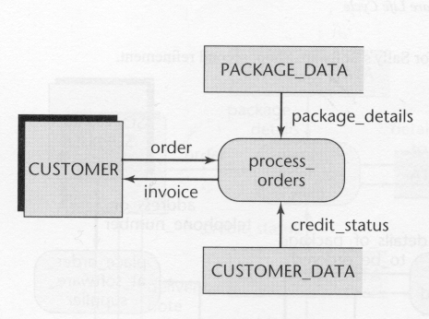
Example #2: First Refinement
1st Refinement DFD for the Software store
Notes:
Here the data store PACKAGE_DATA may consists of items such as boxes or shelves of diskettes, CDs and catalogues. The data store CUSTOMER_DATA may be cards containing customer data such as name, address, contact number, whether their payments are overdue etc…. Finally, the process action process_orders would involve the manual checking of the shelves or catalogues for a particular item; retrieving that item if it was found; verifying that the customer’s credit is good.

Slide 35
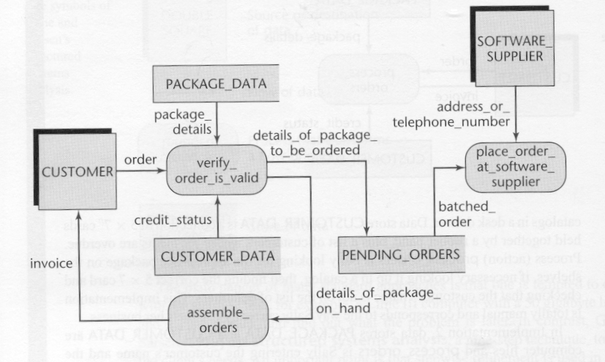
Example #2: Second Refinement
2nd Refinement DFD for the Software store
Notes:
In the second refinement the data stores PACKAGE_DATA and CUSTOMER_DATA are taken to be electronic data files and process_orders is refers to the entering of data such as customer name and the name of the package at a terminal. In short, the DFD below represents a fully computerised solution.
In this case we take into account the scenario where the customer orders a package that is not in stock. Consequently, the details of that package are placed in the data store PENDING_ORDERS. This data store should be scanned on a routine basis either manually or via the computer, and if there are enough orders for one supplier then a batch order should be made. Alternatively, if the orders have been there for a specified period of time (in days) then the order should be made.

Slide 36
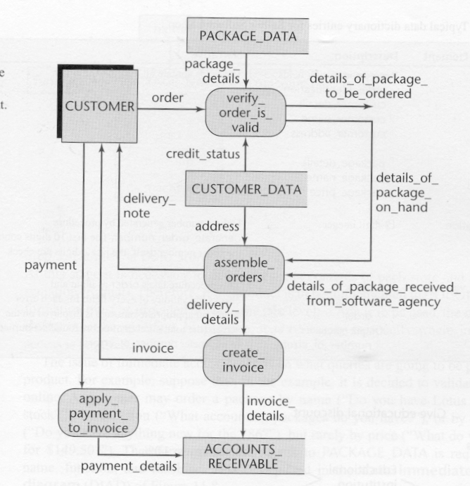
Example #2: Third Refinement
Notes:
. The third refinement picks up from where the second refinement leaves off and shows the logical steps that occur once the software package arrives from the supplier. The partial DFD also examines the financial aspect of accounts receivable. A full solution would contain the additional elements shown in the second refinement as well as other details such as accounts payable.

Slide 37
Entity-Relationship Modelling
Technique which allows relationships between data items to be expressed
Relationships may be one-to-one, one-to-many or many-to-many
Used primarily in the design of databases
Notes:
See online notes for composer example

Slide 38
Formal Techniques
Rely on mathematical sophistication
Includes finite state machines, petri nets and formal languages such as Z and VDM.
Requires high level of mathematical training to use
Notes:
Z is European
VDM is American

Slide 39
Pros & Cons of techniques
Informal techniques are easy to use and understand by client
Formal techniques are highly expressive and correctness can be proved using maths.
Informal techniques may be ambiguous, lack clarity of formal techniques
Formal techniques are hard to learn, client may have difficulty grasping concepts

Slide 40
Pros & Cons Cont’d
Many times the technique used will depend on the ability of client to understand the technique
For a client not having persons with a formal (maths) background, informal or semi-formal approaches may be the only viable ones.

Slide 41
What type of testing is done during the specification phase?
These have been mentioned before, namely…
  Walkthrough of specification document
  Inspections process
  Use of correctness proving (where formal technique is used)
Notes:
- Walkthrough of specification document (see previous notes..)
- Inspections
- Use of correctness proving (in the case where formal technique used)

Slide 42
Software Tools
Graphical tool – to construct diagrams, charts, drawings etc.
Data Dictionary(DD) tool – to store relationships between attributes
Combo Graphical/DD tool
Notes:
Data Dictionary – “An organized listing of all data elements that are pertinent to the system, with precise, definitions so that both user and system analyst will have a common understanding of inputs, outputs, components of stores and [even] intermediate calculations.”
e.g. telephone number:
name: telephone number
aliases: telnum, phonenum
where used/ when used : Dial phone (input)
Content Description:
telephone number = prefix + access number
prefix = [* a four digit number that starts with 9]
access number = *an size number string *
An Example of a telephone number is 9246 4299999
NB: Another field is supplementary information. This deals with any preset values (if known), restrictions, limitations, data type information etc…

Slide 43
What are some useful metrics in the specification phase?
Number of pages in specification document. This allows comparison with past documents to give a sense of the scale of the current product being developed
Rate at which faults are found may also indicated how good spec. team is
Notes:
In Requirements we used volatility
In Test we use LOC, KDSI, # of conditional statements.

Slide 44
What are some useful metrics in the specification phase cont’d?
Number of potential files, processes, components etc. can also preview the eventual effort required.

Slide 45
Use the Quiz for a Quick Recap
Do you want a quick recap? Why not use the quiz?
  Use either the immediate feedback version
    Provides a correct or incorrect message response after each question
  Or, the non-immediate feedback version

Slide 46
The requirements phase is the most important phase in the development process.
Requirements and Specifications Quiz
Question 1
A
Yes
B
No
C
Probably
Peek
Click Peek to lookup the answer in the notes.
Skip

Slide 47
Which of the following is probably the best requirements elicitation approach?
Requirements and Specifications Quiz
Question 2
A
Questionnaires
B
Scenarios
C
Client documents
D
Interviews
Peek
Click Peek to lookup the answer in the notes.
Skip

Slide 48
Questionnaires can have open ended questions.
Requirements and Specifications Quiz
Question 3
A
True
B
False
Skip

Slide 49
Client documents do not help designers understand the types of data.
Requirements and Specifications Quiz
Question 4
A
True
B
False
Peek
Click Peek to lookup the answer in the notes.
Skip

Slide 50
A requirements document can be tested using:
Requirements and Specifications Quiz
Question 5
A
Inspections
B
Structured Walk Throughs
C
Both of the above
D
None of the above
Skip

Slide 51
Scenarios help analysts discover new requirements.
Requirements and Specifications Quiz
Question 6
A
True
B
False
Peek
Click Peek to lookup the answer in the notes.
Skip

Slide 52
The rate of convergence of requirements while discovering and authoring requirements is measured by which metric?
Requirements and Specifications Quiz
Question 7
A
Frequency of use
B
Overall requirements volatility
C
Requirements volatility
D
Rate of convergence
Skip

Slide 53
Z is used in which of the following methods of presenting specifications?
Requirements and Specifications Quiz
Question 8
A
Informal
B
Semi-formal
C
Formal
D
None of the above
Peek
Click Peek to lookup the answer in the notes.
Skip

Slide 54
A data dictionary:
Requirements and Specifications Quiz
Question 9
A
Stores records in a database
B
Stores relationships between attributes
C
Both of the above
D
None of the above
Peek
Click Peek to lookup the answer in the notes.
Skip

Slide 55
Which of the following is not a metric?
Requirements and Specifications Quiz
Question 10
A
Number of potential components
B
Frequency of use
C
Fault discovery rate
D
Number of pages in a requirements document
Peek
Click Peek to lookup the answer in the notes.
Skip

Slide 56
Congratulations
You have successfully completed the quiz
Click here to see your report card

Slide 57
Reflective Question
Is the lack of metrics in the requirements phase a significant reason for poor quality software? Do you think that this is the case in the Caribbean?

Slide 58
Conclusions
In this session the reader was:
  Exposed to different methods of requirements elicitation
  Introduced to modeling using data flow diagrams and entity relationship diagrams
  Made aware of several metrics for the requirements and specification phases of development

Slide 59
References
Sommerville, Ian. 2004. Software Engineering. 7th ed. USA: Addison Wesley

